Slide 1

Advancements in Self-Healing Software Systems: The Rise of AI-Driven Resilience
Presentation By:
IBRAHIM BASHEER K
TLY22CS027
S7 CSE
Guided By:
Mrs. SHEJINA V
Notes:
1

Slide 2
Abstract
This seminar explores self-healing software, a paradigm where systems autonomously detect, diagnose, and repair faults. We will examine how AI and ML are shifting software maintenance from a reactive, manual process to a proactive, automated one. The presentation covers core concepts, architectural patterns, AI-driven methodologies, and real-world case studies. We will also address challenges and look ahead to the future of truly autonomous, resilient systems, where systems not only self-diagnose but also evolve and adapt to new threats and requirements.
Notes:
2

Slide 3
Agenda
  Introduction: What is Self-Healing Software?
  Problem Definition: Why This is a Critical Field
  Objective: The Core Goals of Self-Healing
  Historical Evolution: Path to Autonomy
  Foundational Concepts: Fault Tolerance Strategies
  Methodology: The AI-Driven Architecture
  Case Studies
  Challenges
  Future Directions
  Conclusion
Notes:
3

Slide 4
Introduction: What is Self-Healing Software?
Definition
Biological Analogy
Core Principle
A system that can recognize it is operating incorrectly and, without human intervention, takes corrective action to restore itself to a normal state. This encompasses automatic detection, diagnosis, and remediation.
It mimics a biological immune system, autonomously responding to threats and recovering from failures to maintain its "health" and functional integrity, much like how the body repairs itself.
A fundamental shift from traditional, reactive maintenance to a proactive, resilient, and autonomous form of remediation where the system dynamically fixes itself, often before human operators are even aware of an issue.
Notes:
4

Slide 5
Problem Definition: Why We Need Self-Healing Systems
Increasing System Complexity
High Cost of Failure
Modern architectures involving microservices, serverless computing, and the Internet of Things (IoT) have become too intricate and distributed for effective manual management and debugging.
System downtime leads to major financial losses (e.g., millions per hour for large enterprises), severe reputational damage, and significant safety risks in critical sectors like healthcare, finance, and autonomous vehicles.
Limitations of Manual Processes
Need for Uninterrupted Resilience
Traditional debugging and incident response are slow, heavily rely on human expertise, and cannot keep pace with the speed of modern DevOps and continuous deployment pipelines, leading to alert fatigue.
24/7 availability and seamless performance are now standard business and user requirements. Self-healing enables systems to maintain these SLAs even in the face of unexpected failures or adversarial attacks.
Notes:
5

Slide 6




Objective: Defining the Goals
The primary objective of self-healing software is to create systems that autonomously maintain their operational integrity, ensuring high availability, reliability, and security with minimal human oversight, thereby fostering true system resilience.
Minimize System Downtime
Enhance System Reliability
Achieve near-zero downtime by rapidly detecting and resolving issues, often before users are impacted, reducing Mean Time To Recovery (MTTR).
Improve overall system robustness and predictability by proactively mitigating risks and automating error correction, leading to consistent performance.
Reduce Human Intervention and Maintenance Costs
Improve Security
Autonomously detect and patch vulnerabilities or isolate compromised components in real-time, significantly enhancing the system's defensive posture against cyber threats.
Automate routine operational tasks, freeing up engineers to focus on innovation rather than fire-fighting, and significantly lowering operational expenses.
Notes:
6

Slide 7
Historical Evolution: The Path to Autonomy
2010s - The AI/ML Revolution
1970s - Fault Tolerance
The rise of machine learning enables sophisticated predictive analytics, real-time anomaly detection, and automated root cause analysis, shifting systems towards proactive healing.
The concept begins with research into fault-tolerant computing, employing hardware redundancy and basic failover mechanisms to survive single-point failures.
1
2
3
4
1990s - Autonomic Computing
2023+ - The Generative AI Era
IBM's Autonomic Computing Initiative (ACI) introduced the concept of self-managing systems (self-healing, self-optimizing, self-configuring), laying the theoretical groundwork.
Large Language Models (LLMs) begin to demonstrate the ability to not only understand but also automatically generate and repair code, transforming possibilities for automated correction and adaptive self-healing.
Notes:
7

Slide 8
Foundational Concepts: Fault Tolerance Strategies
1
2
3
Redundancy
Predictive Analytics
Automatic Error Detection
Employing duplicate or backup components (servers, services, data stores) that can immediately take over if a primary component fails.
Utilizing machine learning algorithms to analyze historical and real-time system data, forecasting the likelihood of future failures.
Establishing a baseline of "normal" system behavior using statistical methods and machine learning. Anomaly detection algorithms automatically flag deviations, pinpointing faults or potential issues rapidly.
Notes:
8

Slide 9
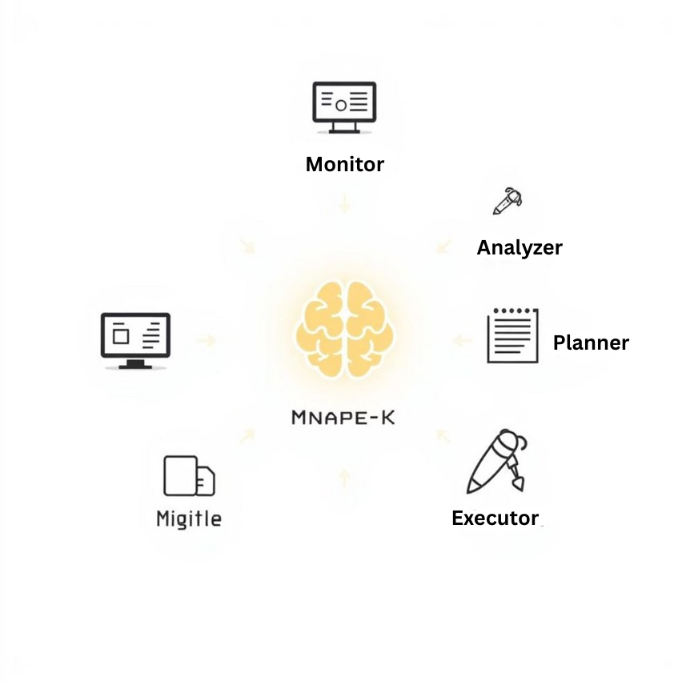
Architecture Patterns for Self-Healing
MAPE-K Model
  Monitor: Continuously collect data from the system's various components and environments.
  Analyze: Process collected data to detect anomalies, diagnose problems, and identify root causes using AI/ML.
  Plan: Based on analysis, decide on a precise course of action to fix the problem or prevent an impending failure.
  Execute: Implement the chosen plan, which could involve reconfiguring, restarting, or re-deploying components.
  Knowledge (K): A shared knowledge base (e.g., policies, historical data, system models) informs and guides the other four steps, evolving over time.
The MAPE-K Model is a foundational reference model for autonomic control. Many self-healing systems are designed based on this continuous loop.
Notes:
9

Slide 10
The Foundation: Observability & AIOps
Self-healing is impossible without accurate, high-quality, and real-time telemetry. This data forms the non-negotiable foundation for autonomous remediation.
The Need for High-Quality Signals
The Rise of AIOps
  Logs: Granular event data and errors from applications and infrastructure components.
AIOps (AI for IT Operations) platforms are essential. They use big data, advanced analytics, and machine learning to automate the process of collecting, aggregating, and analyzing observability data. AIOps transforms raw signals into actionable insights, reduces alert noise, and even automates responses for the healing engine. The AIOps market is projected to grow significantly, reflecting its critical importance in modern IT.
  Metrics: Time-series data on system performance (e.g., CPU utilization, memory consumption, network latency, request rates).
  Traces: End-to-end visibility showing the complete path of a request through complex, distributed systems, enabling root cause analysis across microservices.
Notes:
10

Slide 11
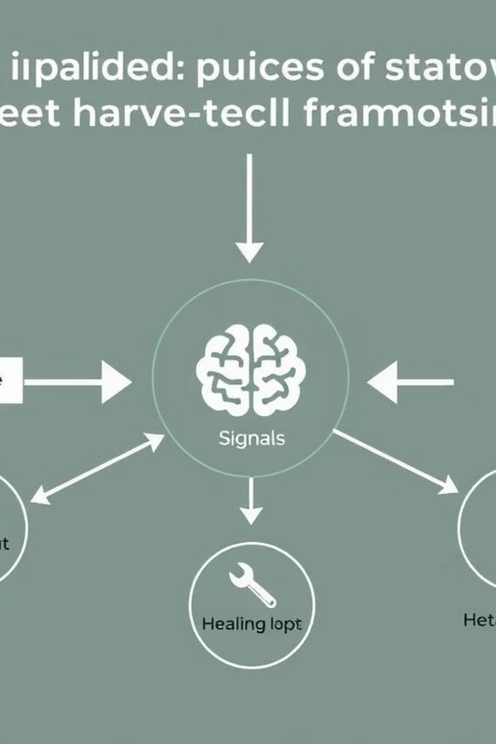
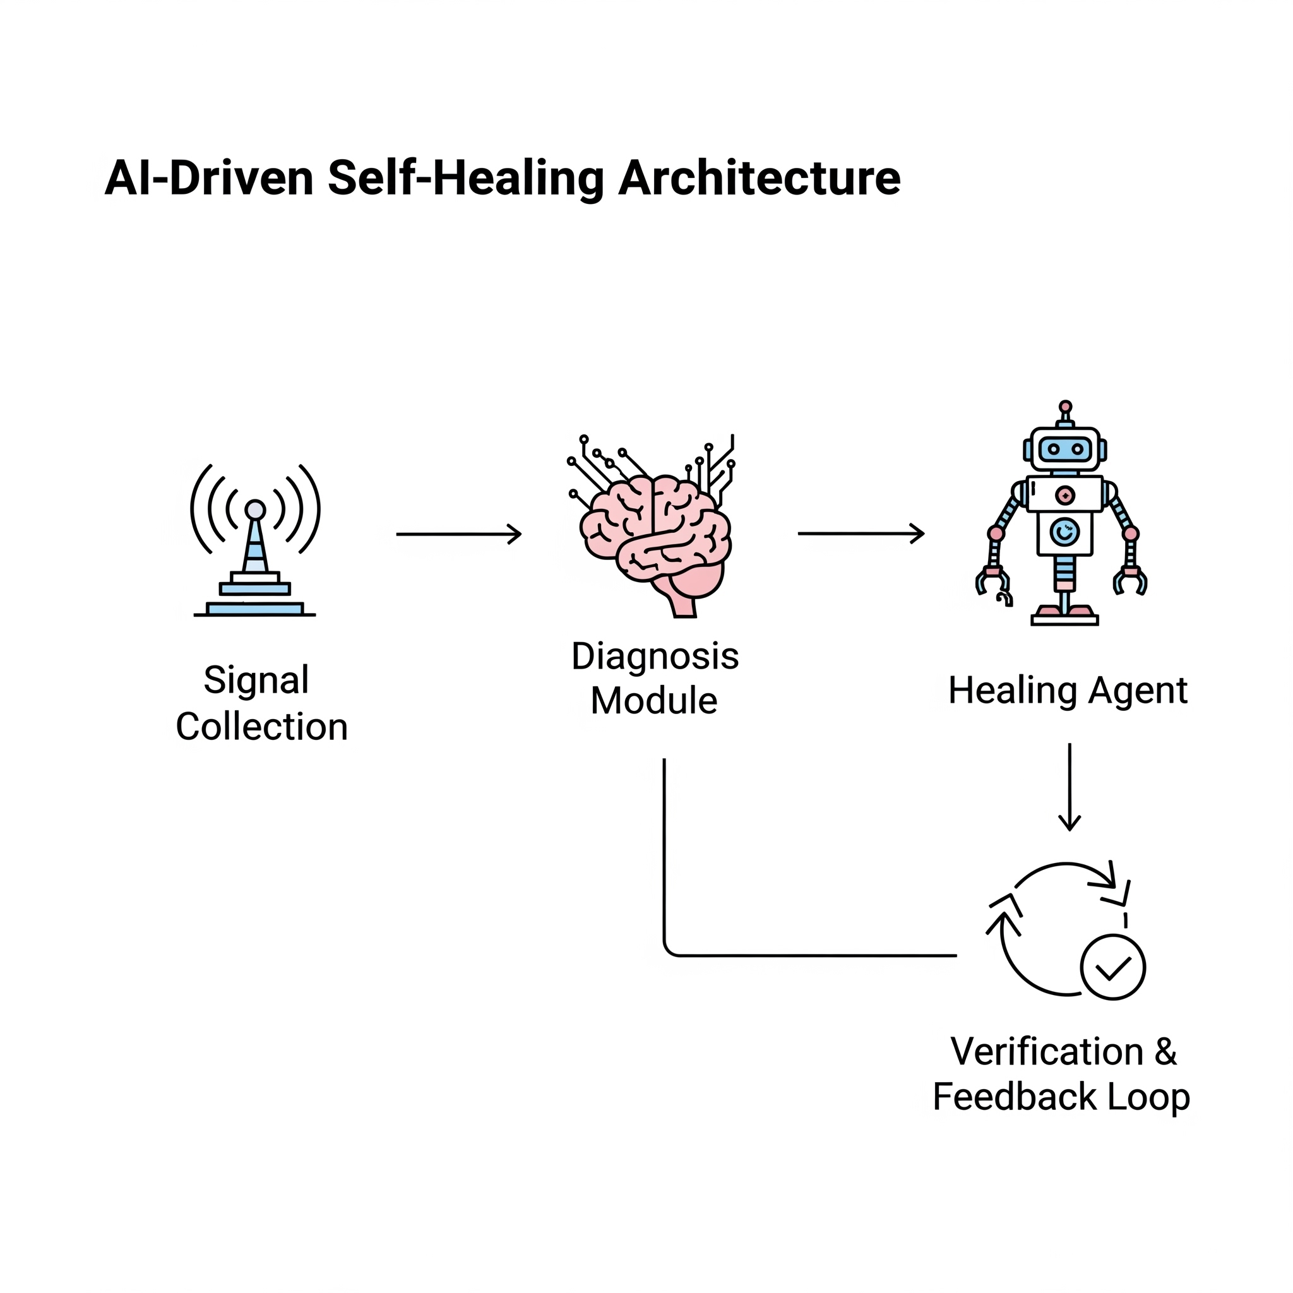
Methodology: An AI-Driven Self-Healing Architecture
This framework, inspired by biological healing processes, provides a robust approach to autonomous software repair.
1
Signal Collection (The Nerves)
Observability tools and AIOps platforms gather logs, metrics, and traces as sensory inputs to detect system "stress".
2
Diagnosis Module (The Brain)
An AI Orchestration Engine, often using LLMs, analyzes signals and historical data to identify the root cause of a fault.
3
Healing Agent (The Immune Response)
Automated scripts and AI models apply targeted fixes, such as generating code patches or altering configurations.
4
Verification & Feedback Loop
Proposed fixes are tested in a sandboxed environment, with outcomes logged to a knowledge base for continuous improvement.
Notes:
11

Slide 12
The Engine: A Deep Dive into Key AI & ML Techniques
Anomaly Detection
Predictive Analytics
Unsupervised models (e.g., clustering) or sequence models like RNNs and LSTMs identify abnormal behavior in runtime logs and performance metrics.
Supervised models, such as decision trees, are trained on historical bug report datasets to forecast potential failures in new code.
Reinforcement Learning (RL)
Automated Program Repair (APR) with LLMs
AI agents learn effective repair strategies over time, receiving "rewards" for successful fixes to adapt their error-handling policies.
Large Language Models analyze faulty code and error messages to automatically generate corrective code patches.
Notes:
12

Slide 13



Case Studies: Self-Healing in the Wild
Real-world applications showcase the tangible benefits of self-healing software across diverse industries.
Cloud Infrastructure
Facebook Sapienz
Google ClusterFuzz
Companies like Amazon and Google utilize self-healing protocols for high availability, automatically resolving server overloads, network failures, and node issues.
An AI-powered tool that automatically finds bugs and generates tests to trigger crashes in mobile applications, detecting issues before production.
A large-scale, AI-powered fuzz testing platform using machine learning to intelligently find security vulnerabilities in software.
Notes:
13

Slide 14
Measuring Success: Key Performance Metrics
Quantifying the effectiveness of self-healing systems is crucial for demonstrating their value and guiding further development.
MTTR
90%
Mean Time To Repair
Repair Success Rate
Average time from failure detection to resolution; a primary goal for self-healing systems is to lower this metric.
The percentage of automated fixes that correctly resolve an issue without introducing new regressions.
F1-score
Hours
Bug Detection Accuracy
Developer Effort Saved
The F1-score (balancing precision and recall) of the system in identifying genuine faults while minimizing false positives.
The quantifiable reduction in manual hours developers spend on debugging and repetitive maintenance tasks.
Notes:
14

Slide 15
Challenge 1: Technical & Algorithmic Hurdles
Implementing AI-driven self-healing systems presents several complex technical and algorithmic challenges.
AI Hallucinations & Wrong Patches
Lack of Semantic Understanding
Data Quality & False Positives
LLMs can generate plausible but incorrect or harmful code, necessitating robust verification and sandboxing.
AI models often struggle with complex, domain-specific business logic, leading to lower success rates for semantic bugs.
Effective AI models depend on high-quality training data; biased or insufficient data can lead to poor fixes and high false positives.
Notes:
16

Slide 16
Challenge 2: Security, Ethical & Integration Hurdles
Beyond technical issues, self-healing software faces significant hurdles in security, ethics, and integration with existing systems.
Security, Trust, and Accountability
Computational Overhead & Cost
Integration Complexity
Integrating modern self-healing frameworks into legacy or monolithic systems requires custom adapters and substantial engineering effort.
The "black box" nature of AI raises questions of responsibility for new vulnerabilities, demanding clear governance and audit trails.
Continuously running monitoring tools and large AI models can be resource-intensive and expensive, posing deployment challenges.
Notes:
17

Slide 17




Future Directions: The Road Ahead
The evolution of self-healing software promises a more autonomous and resilient future for software systems.
Deeper DevOps Integration (AIOps)
Self-healing will become a standard component of CI/CD pipelines, preventing faulty releases and managing software quality.
Multi-Modal AI Models
The next wave of AI will correlate signals from multiple sources—code, performance graphs, and runtime logs—for holistic system health.
Reinforcement Learning from Experience
Systems will dynamically adapt healing strategies based on continuous feedback, learning from past outcomes to optimize for success.
Self-Healing for AI Systems
A meta-level approach where AI monitors, diagnoses, and repairs other AI/ML models running in production.
Notes:
18

Slide 18
Future Spotlight: Explainable AI (XAI)
XAI is critical for building trust and enabling broader adoption of AI-driven self-healing solutions.
The Problem: "Black Box" AI
The Solution: XAI
The opaque nature of complex AI models hinders adoption. Developers need to understand and trust AI's reasoning before deploying fixes in critical systems.
XAI provides human-understandable explanations for AI outputs, making its decision-making process transparent.
Application Example
Impact
Instead of just applying a patch, the system would explain: "This patch adds a null check because a null pointer exception was detected in 75% of recent failures."
XAI builds developer trust, aids in debugging the healer, and provides clear audit trails essential for accountability and regulatory compliance.
Notes:
19

Slide 19
Conclusion: Towards Autonomous Software
A Paradigm Shift
AI: The Core Enabler
Self-healing transcends reactive maintenance, ushering in a proactive, automated, and inherently resilient era for software engineering. This evolution moves beyond simple fixes to predictive and preventive measures.
Advanced AI, particularly in machine learning, deep learning, and generative models, is transforming self-healing from a complex concept into a tangible, practical reality for enterprise systems.
Evolutionary Necessity
The Journey Ahead
As software scales in complexity and criticality, self-healing is no longer optional. It's a fundamental capability ensuring system stability, robust security, and uninterrupted uptime, especially for mission-critical applications.
While challenges remain, the clear trajectory is toward more intelligent, adaptive, and autonomous software systems that will redefine digital world construction and maintenance.
Notes:
20

Slide 20
References: Key Research & Insights
  Baqar, M., Khanda, R., & Naqvi, S. (2023). Self-Healing Software Systems: Lessons from Nature, Powered by AI. arXiv preprint. This paper explores bio-inspired approaches to self-healing, bridging natural resilience with AI applications in software.
  Kathiresan, G. (2023). Self-Healing Software: Leveraging AI for Automated Bug Detection and Real-Time Code Correction. CINEFORUM, 63(3). Focuses on AI's role in proactive fault identification and automated code remediation within live systems.
  Konda, S. R. (2024). Advancements in Self-Healing Technology for Software Systems. International Journal of Engineering Research and Applications, 14(1). A comprehensive overview of recent technological breakthroughs and future directions in self-healing.
  Yazdanparast, Z. (n.d.). A Survey on Self-healing Software System. Tarbiat Modares University. Provides foundational knowledge and categorizes existing self-healing mechanisms.
Additional Sources:
  Gartner (2024). Market Guide for AIOps Platforms. Insights into the commercial landscape and integration of AI in IT operations.
  Ahmed, F., et al. (2023). Multi-Modal Transformer for Software Fault Localization Using Logs, Code, and Telemetry. 45th International Conference on Software Engineering (ICSE). Highlights cutting-edge research in utilizing diverse data sources for precise fault identification.
Notes:
21

Slide 21
Thank You
Notes:
22

